Slide 1

PROJECT ENERGYCITE | REF. EC-2026-001
Keningford Partners
Where Smart Energy Was Born
Patented real-time home energy management delivered through U.S. utilities
Investor Pitch • $5M Raise
25
Years in business
7
Granted patents
98M
Projected Served Market Segment in 3 years

Slide 2

Overview
ENERGYCITE, INC.
25 years in business
Helped bring the modern smart utility meter to the U.S.
01
COVERAGE SNAPSHOT
166
Patented real-time app
Shows homeowners electricity use and cost and lets them control it from their phone.
Investor-owned utilities served
02
50
Top-50 municipal utilities
98M homes reachable
Sold through 166 investor-owned and top 50 municipal utilities.
03
98M
Reachable homes: 70% of 140M meters
7 patents
Granted in the U.S., Israel, China and the EU, with a planned residential beta project underway.
4
04
Patent jurisdictions: US · IL · CN · EU

Slide 3
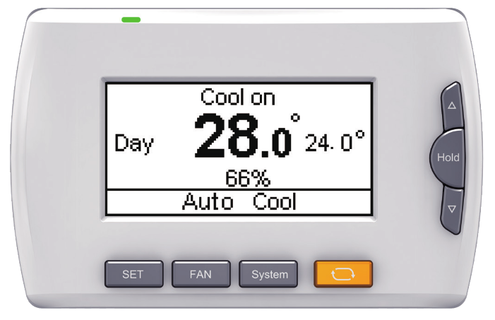
The Product
ENERGYCITE, INC.
01
Real-time display
Meter data reaches a mobile smart phone such as an iPhone or Android, showing utility commodity use, showing use in kWh, dollars and running costs for the current billing cycle.
Open standards
Built on ANSI and ZigBee, working with smart thermostats, appliances, EV chargers and home controllers.
02
Private by design
A firewall keeps each customer's data private.
03
Scales fast
Minimal hardware cost, running on meters already installed.
MOBILE APP
04

Slide 4
Market Opportunity
98M homes
70% of the 140M installed U.S. smart meters, served by 166 investor-owned and top 50 municipal utilities, all reachable through the utility model.
Pricing tailwind
Nearly all U.S. utilities now use tiered, time-of-use and dynamic peak pricing, making real-time cost visibility more valuable than ever.
Proven behavior
For two decades, studies show people use less power when they see cost in real time, fitting utility demand-response and efficiency goals.

Slide 5
Market Size and Third-Year Revenue
ENERGYCITE, INC.
140 million meters installed
U.S. utilities have deployed 140M residential smart electric meters which is the base our app rides on.
01
POST–YEAR-3 VALUATION
$2.8B – $4.7B
3-5× gross annual revenue of $940.8M
Recurring license revenue, billed monthly by the utility.
98 million served market
70% of that installed base is reachable through IOUs and large municipal utilities.
02
$940.8M gross, year three
98M meters × $0.80 per month = $9.60 per meter per year.
03
Gas and water add upside
Electric only. Gas and water meters add the same recurring fee.
04

Slide 6
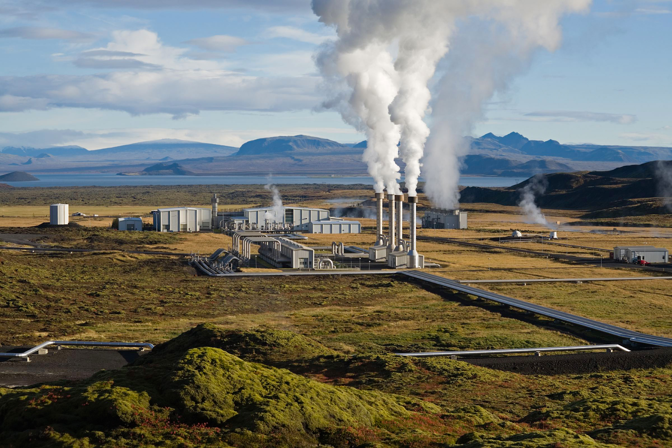
EnergyCite and Geothermal
ENERGYCITE, INC.
Firm power needs firm metering
Always-on baseload still needs the measure-and-control layer we own.
01
Same channel, nothing to build
The 216 utilities we sell through are the buyers signing geothermal PPAs.
02
Cheaper power, visible savings
Power below gas cost gives utilities a savings story our app makes visible.
03
Fusion stays on the roadmap
Geothermal is the near-term revenue path; fusion is the long-horizon option.
GEOTHERMAL PLANT
04

Slide 7
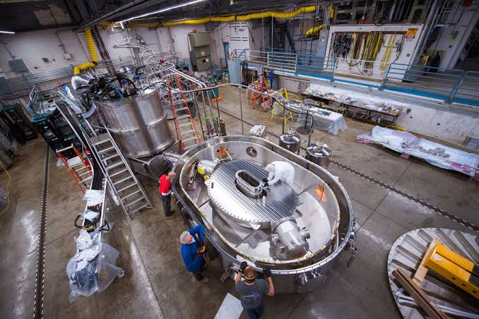
Fusion: The Long Horizon
ENERGYCITE, INC.
Where fusion stands today
Laboratory milestones are real, but commercial power remains decades out.
01
Why we still track it
Fusion is portable, fuel-dense power for uses geothermal can never reach.
02
Our role does not change
Whatever generates the electron, the home still needs measurement and control.
03
FUSION RESEARCH FACILITY
Sequencing for investors
Geothermal funds this decade; fusion is optionality, not the base case.
EnergyCite plans on distributing most of its net earnings to fusion energy R&D projects once its shareholder exit strategy has been executed.
04

Slide 8
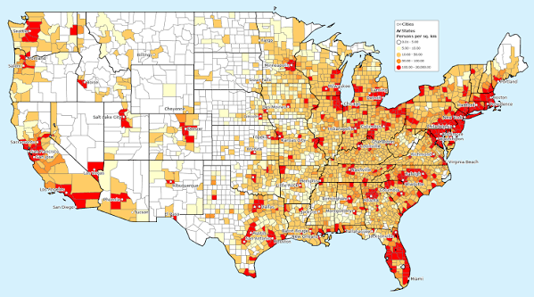
Business Model
$0.80 per home / month
Billed through the utility, with a small share paid back.
Very high margin
Runs on meters already installed, so costs stay low.
Recurring revenue
Repeats every month, subscriber after subscriber.
$940.8M potential
Within three years of beta (full take-up) at today's price.
U.S. MARKET REACH
98M homes reachable across 216 utilities

Slide 9
Revenue Potential
($ in USD; annual recurring revenue)
Market penetration | Subscribers | Annual recurring revenue
1% | 980,000 | $9.4M
5% | 4,900,000 | $47.0M
10% | 9,800,000 | $94.1M
25% | 24,500,000 | $235.2M
50% | 49,000,000 | $470.4M
100% (full market) | 98,000,000 | $940.8M

Slide 10
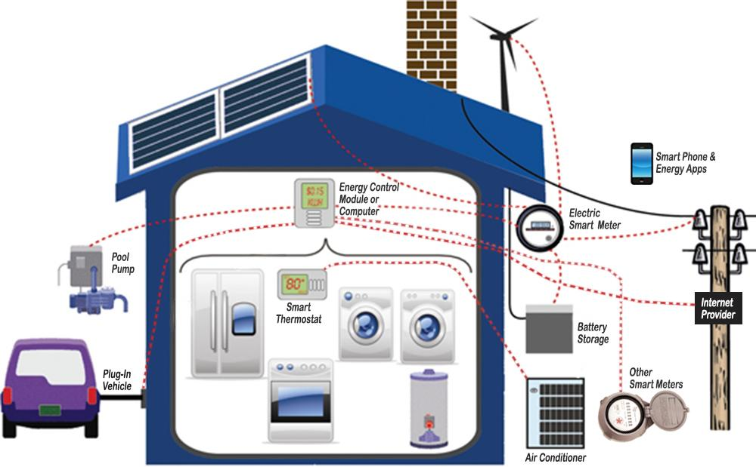
Competitive Moat
7 patents
Cover the whole system: the smart meter, the system link, and the in-home display app.
Hard to replicate
The company believes rivals can't match this real-time experience without risking infringement.
Built-in channel
Sold by the utility itself, reaching customers directly.
No new hardware
Runs on the utility's existing smart meter.
EnergyCite is also filing additional patent applications to cover the AI software aspects of its smartphone application.
Patent status: one of the seven granted patents lapsed after a maintenance-fee filing was missed by prior counsel. New patent counsel has petitioned the USPTO for reinstatement.

Slide 11
Milestones
Two decades of smart metering R&D have matured into a utility distributed product now moving from beta to nationwide rollout.
PHASE 01
Since 2001
PHASE 02
Software-only pivot
PHASE 03
$3M raised
PHASE 04
Beta nearing completion
PHASE 05
More patents filing
Built smart metering & energy management tech via predecessor USCL Corporation.
Ended the Waison meter hardware effort and committed to a software-only app running on utilities’ existing meters.
Raised through USCL for product development and patents.
Transitioning from development to selling through utilities.
Additional patents filed and prosecuted, expanding protection.

Slide 12
Team
A leadership team pairing decades of utility, metering and entrepreneurial experience.
Tomer Tamarkin
Founder, President & CEO
Introduced the modern U.S. utility smart meter. Founded Tamar Corporation (1990); former VP & GM of Datamatic, Inc.
Pat Boone
VP of Investor Relations, Board Member
Focuses on investor and media relations, and on relationships with senior U.S. government leaders. Does not handle operations.
Emily Tamarkin
Corporate Treasurer, Board Member
Corporate VP and Secretary of USCL Corporation, 1995–2011, managing the firm’s financial statements and bookkeeping.
Robert G. Fulks
Board Member
Investor and financial partner in Mizar, a startup Tomer Tamarkin formed and ran in Phoenix, AZ, in the early 1980s. MIT-trained engineer, 10 patents.
Avi Schwartz
Board Member
Digital and multimedia producer, filmmaker and public speaker. Serves as EnergyCite’s VP of Digital Marketing.
David Glenwinkel
Board Member
Co-founded USCL Corporation with Tomer Tamarkin in 1995. CEO of Executive Management Solutions, a tax and business strategy firm.
Dr. Valentina Zharkova
Board Member
Professor of Mathematics, Physics and Electrical Engineering, Northumbria University, UK. Solar physicist, 200+ published papers.

Slide 13
The Raise
FUNDING GOAL
$5M
To complete the commercial beta and roll out through the nation's investor owned and municipal utilities.
VALUATION
$15M
EnergyCite is offering an equity raise at a $15M valuation to accelerate utility integration.

Slide 14
Thank You
Let's bring real time energy to 98 million homes.
Tomer Tamarkin, President & CEO | EnergyCite, Inc.
$0.80
per home, per month
98M
homes reachable
$940.8M
revenue potential

